Slide 1
Shewolf (Dr. Jean Boudreaux) Remembrance Gathering
Hosted by Sinister Wisdom | May 26th, 2020

Slide 2
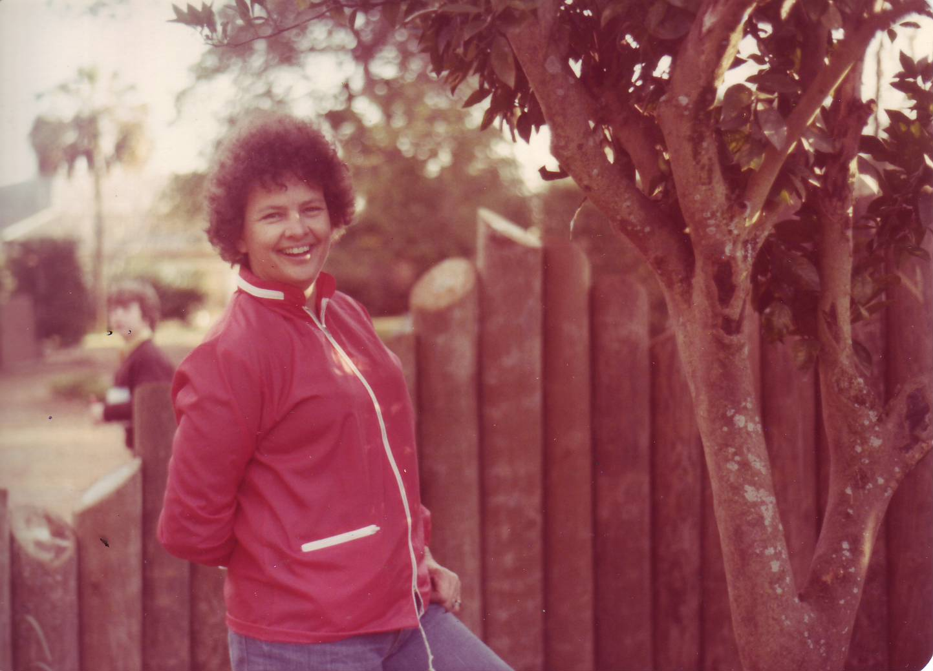
Shewolf, 1979

Slide 3
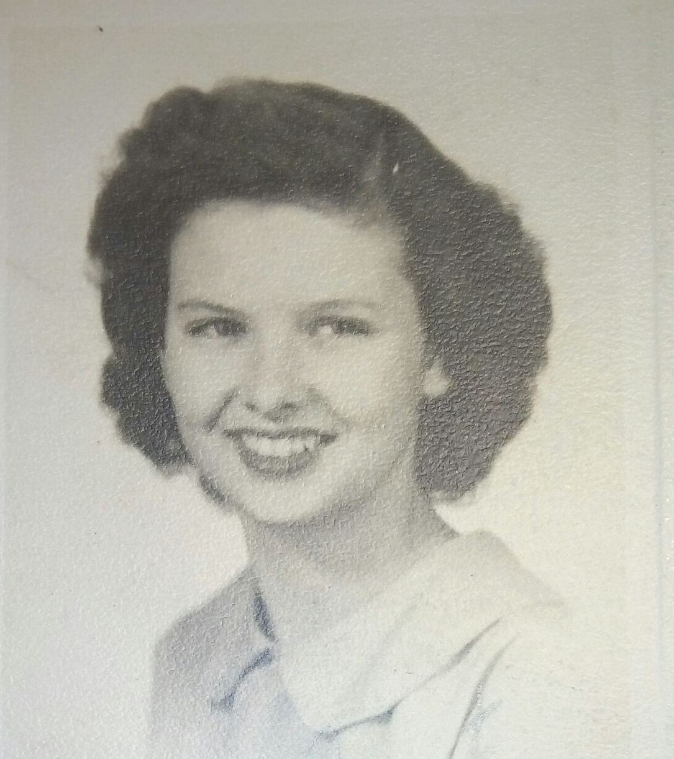
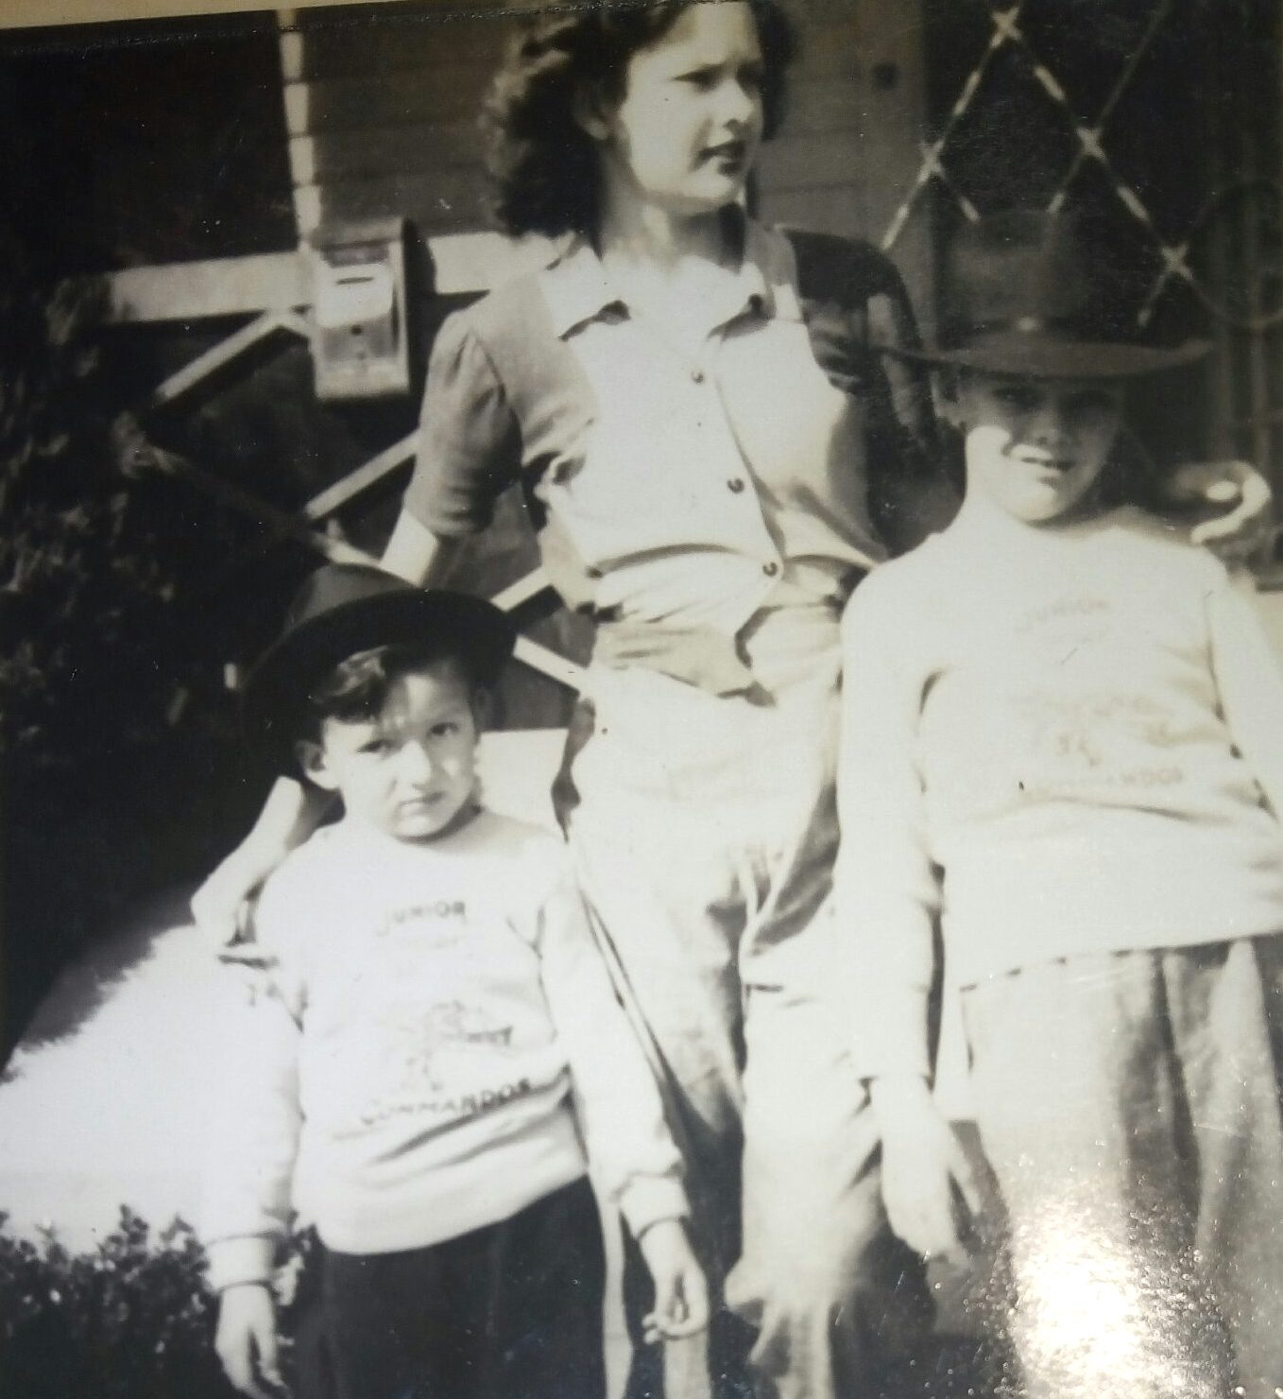

Slide 4
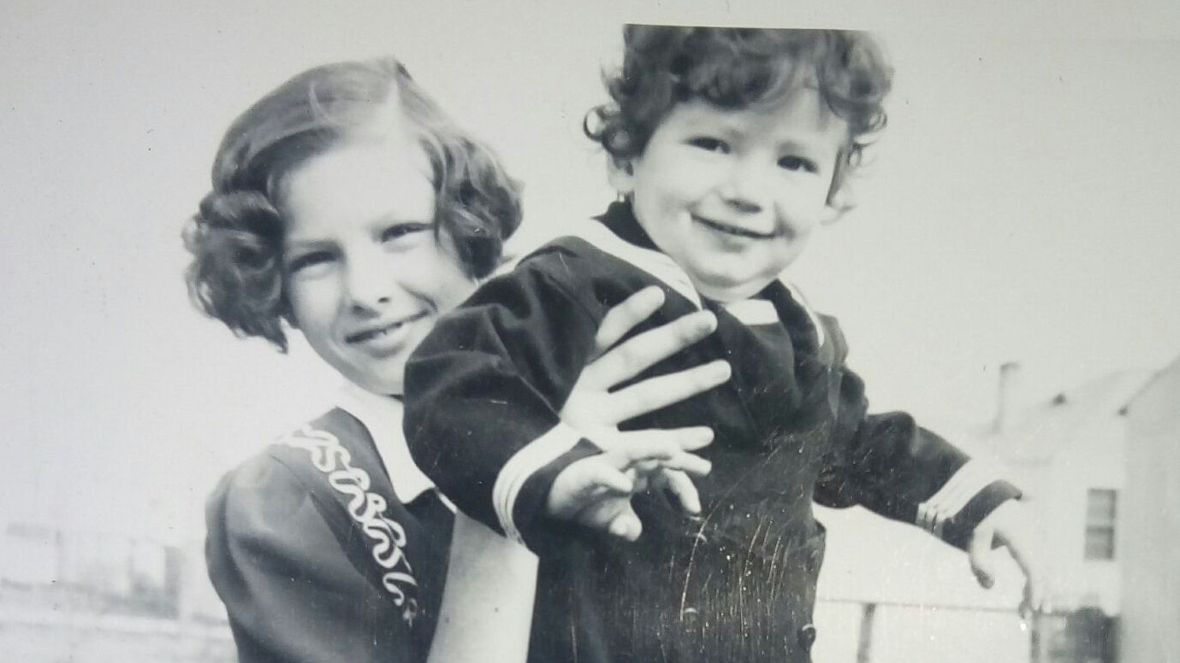

Slide 5
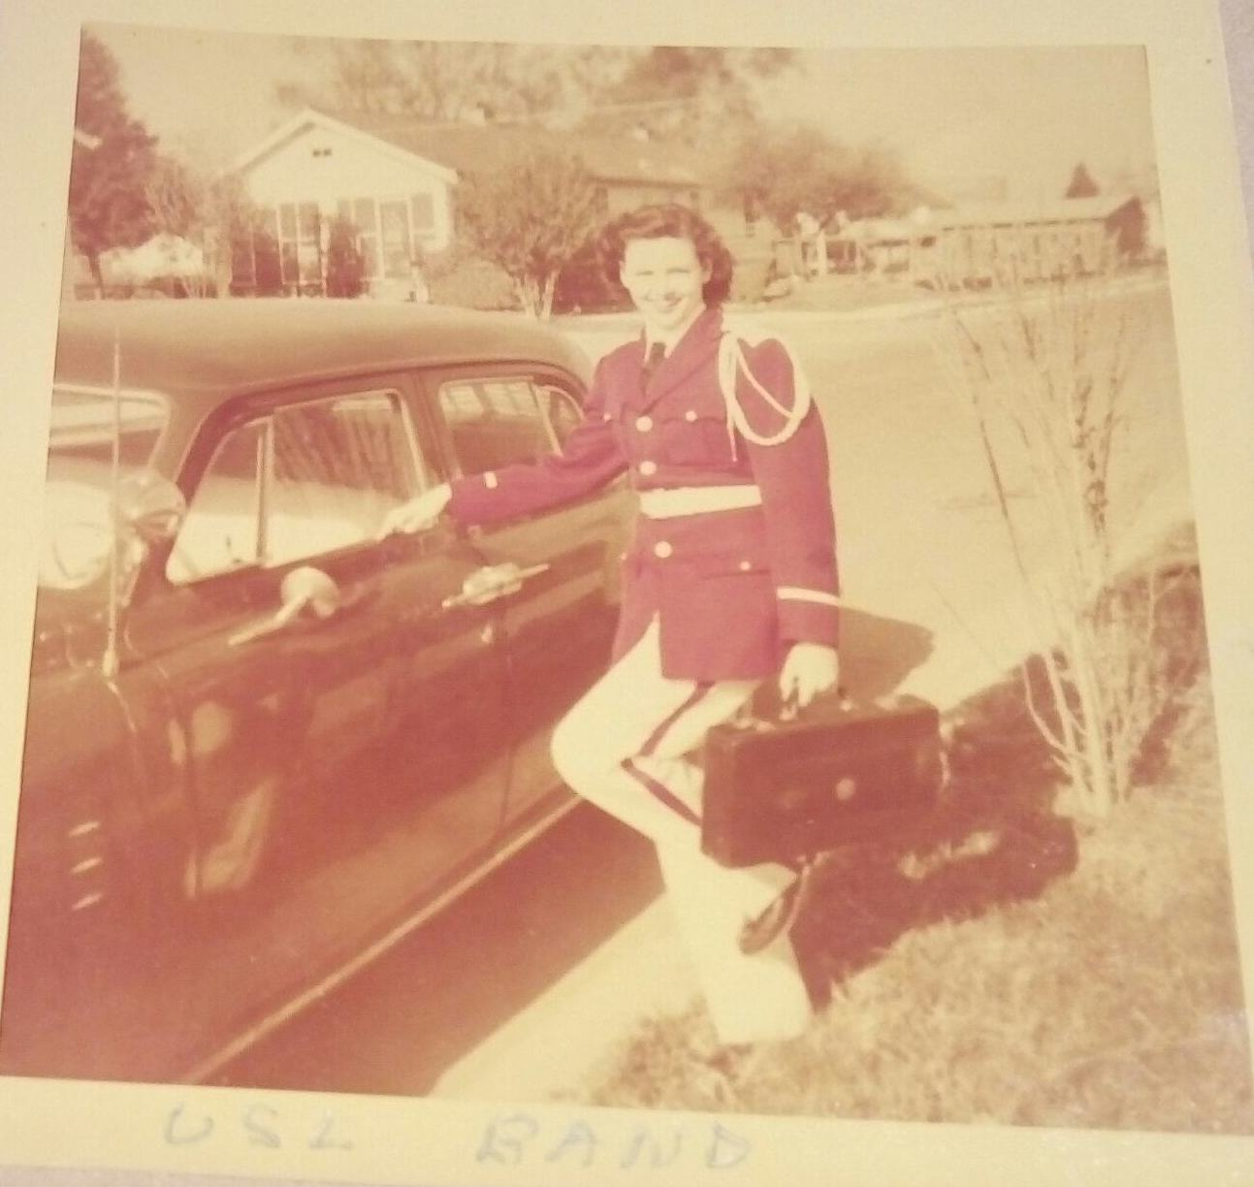

Slide 6
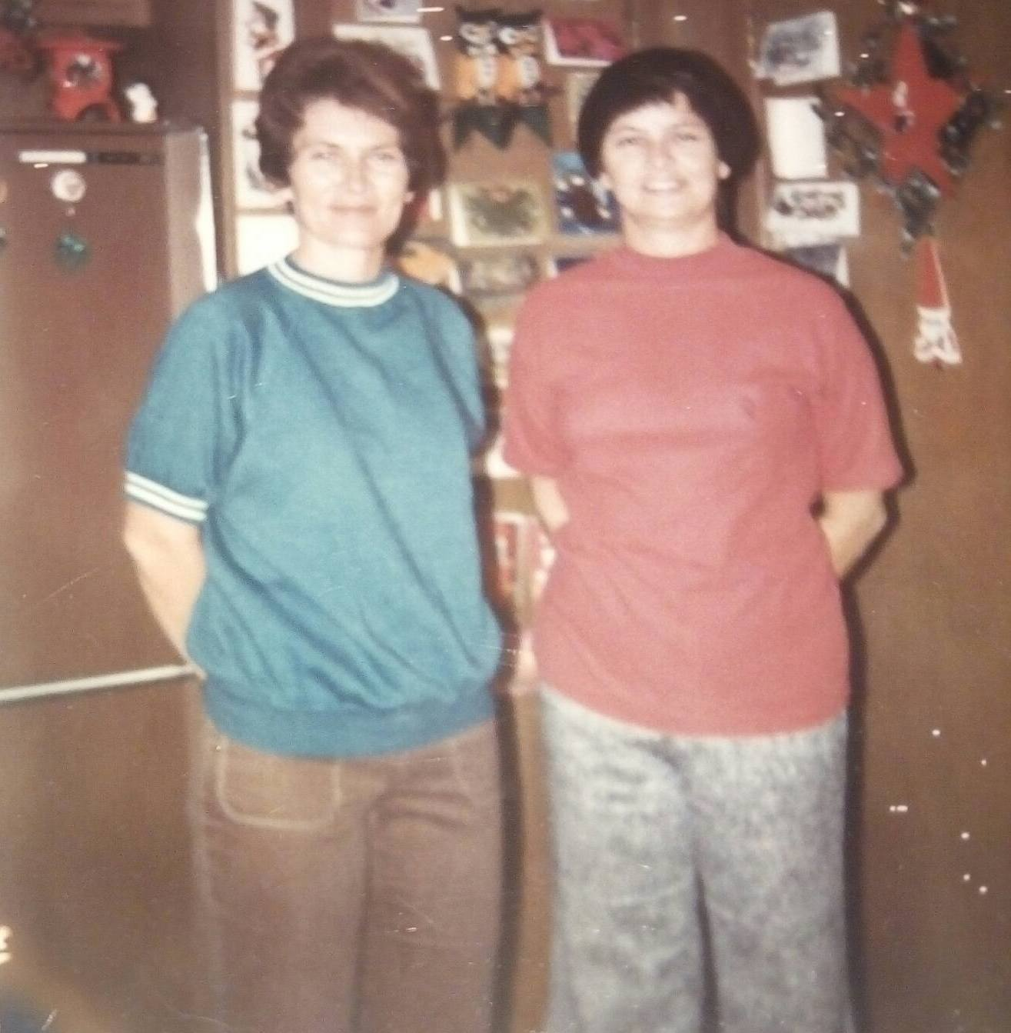
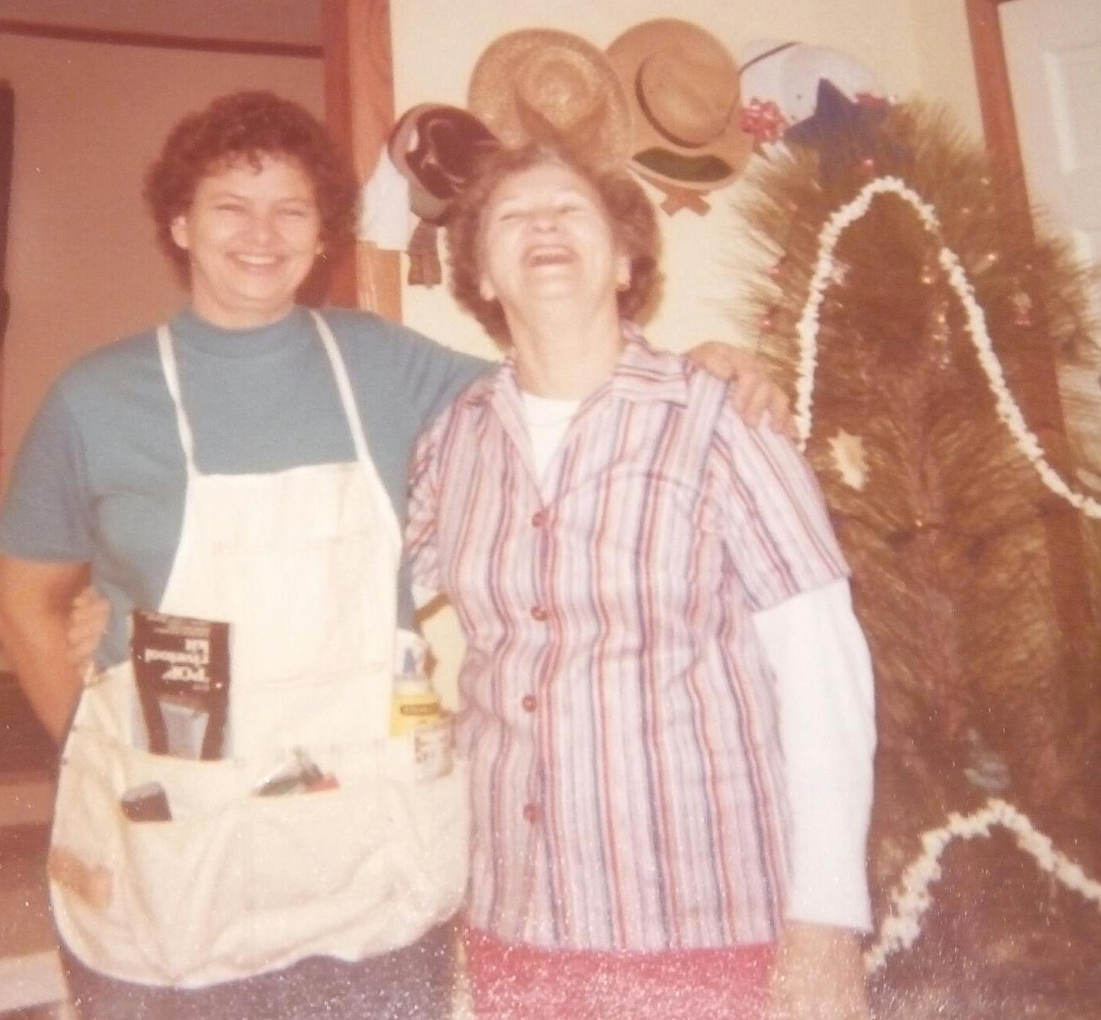

Slide 7
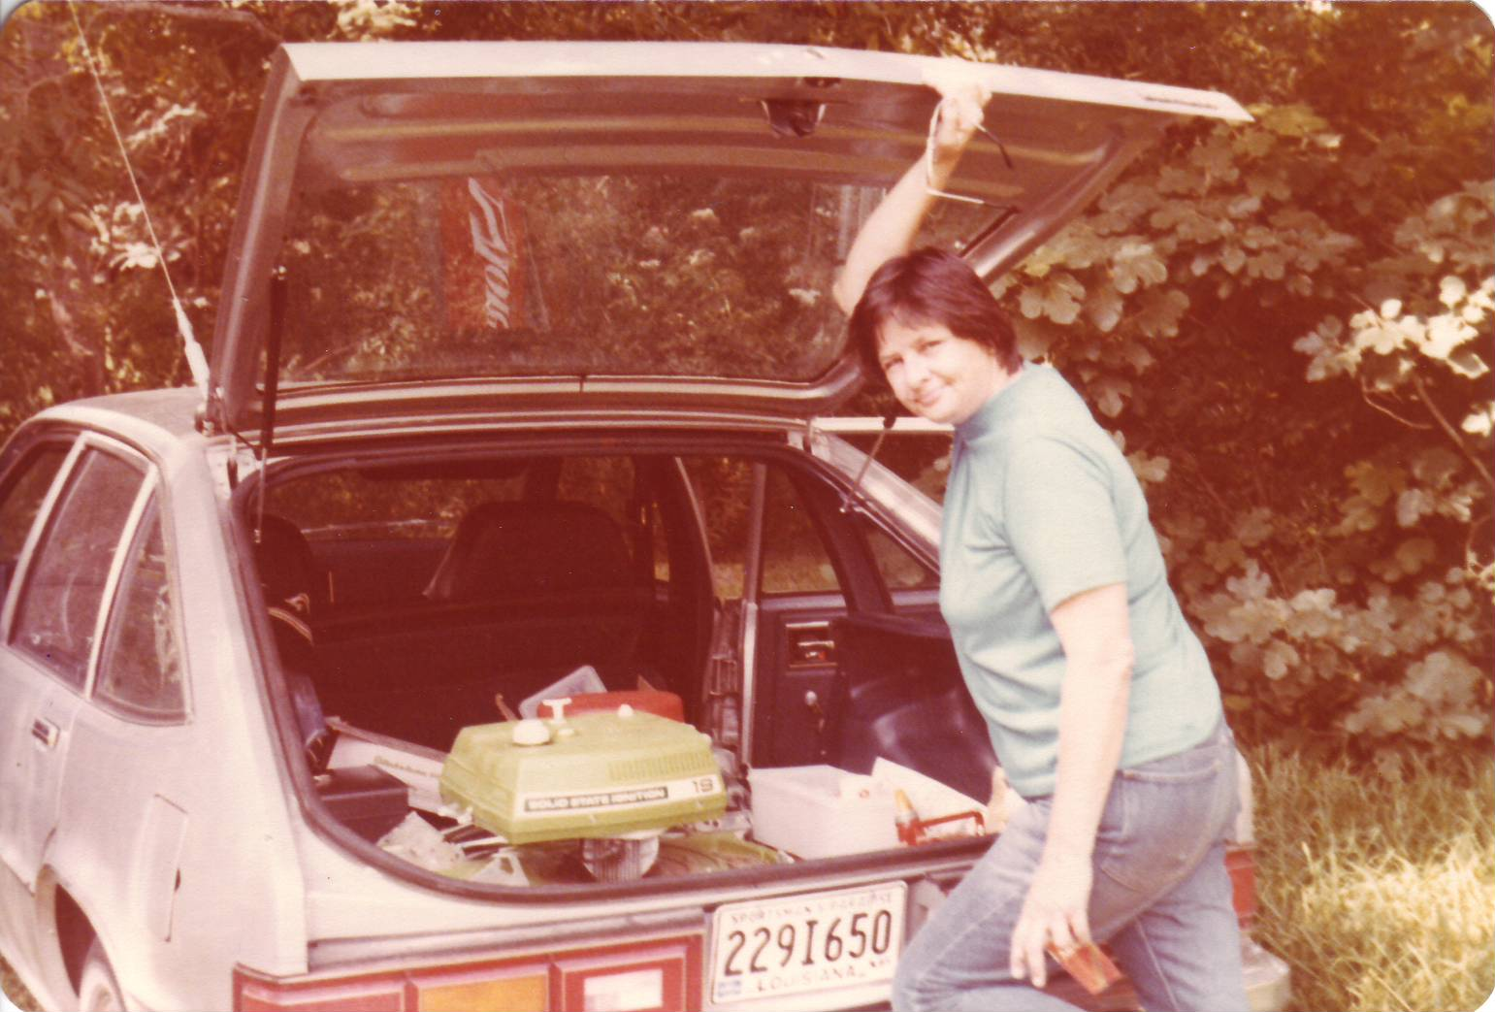
Shewolf at WomanWorld, 1979

Slide 8
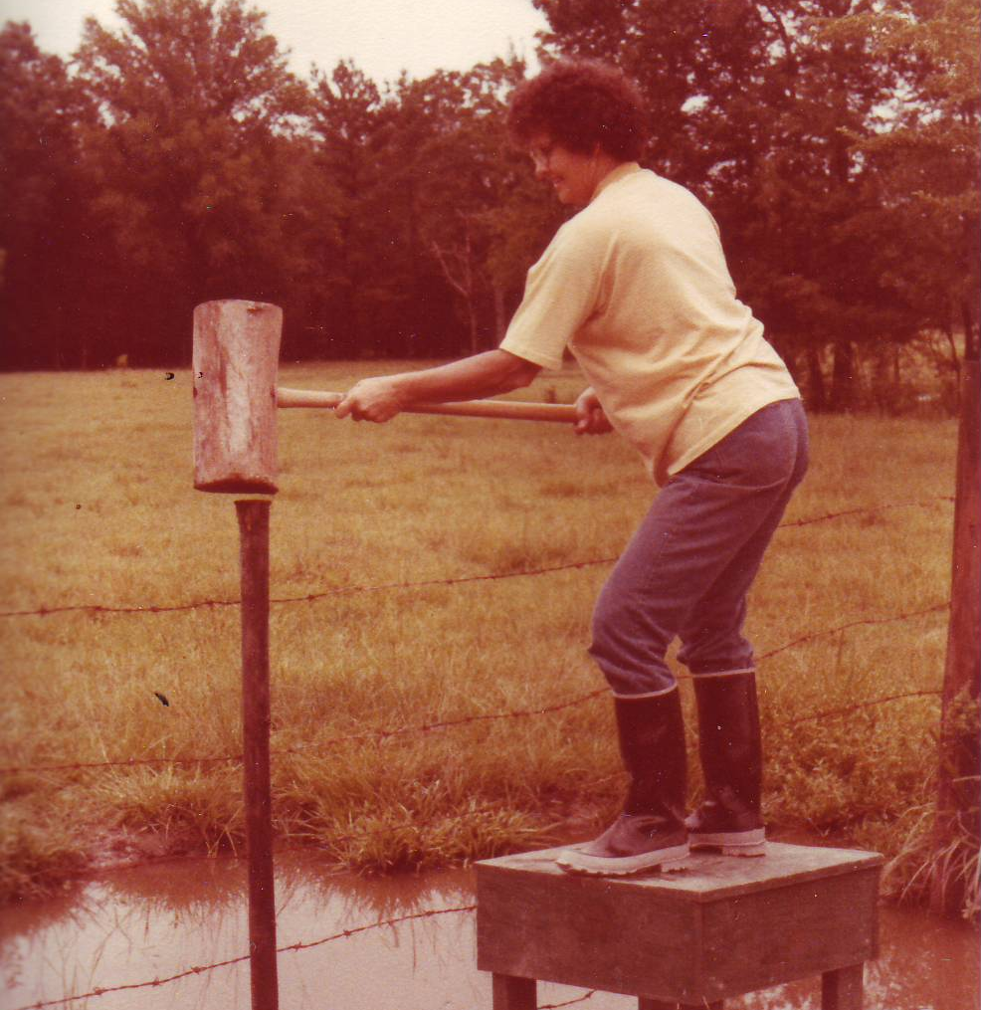
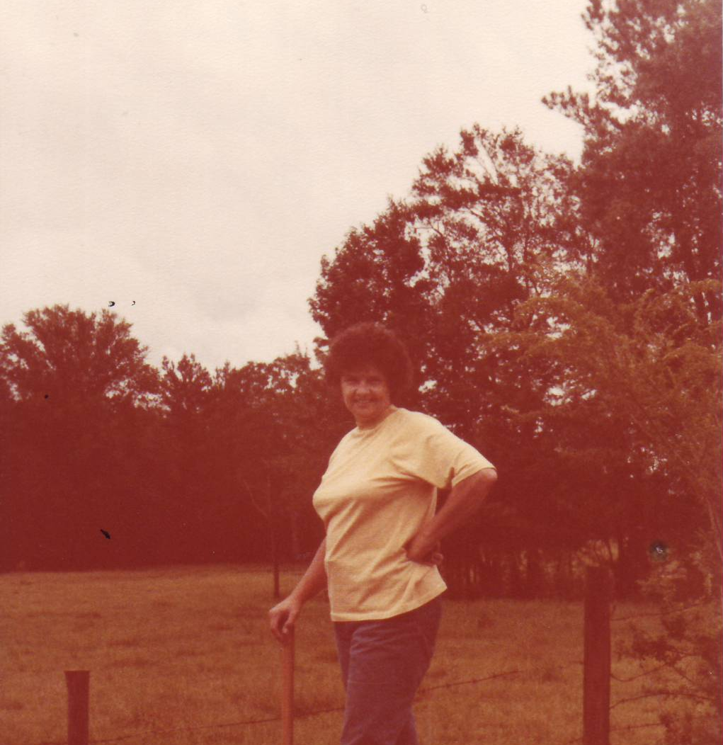
Shewolf at WomanWorld, 1978

Slide 9
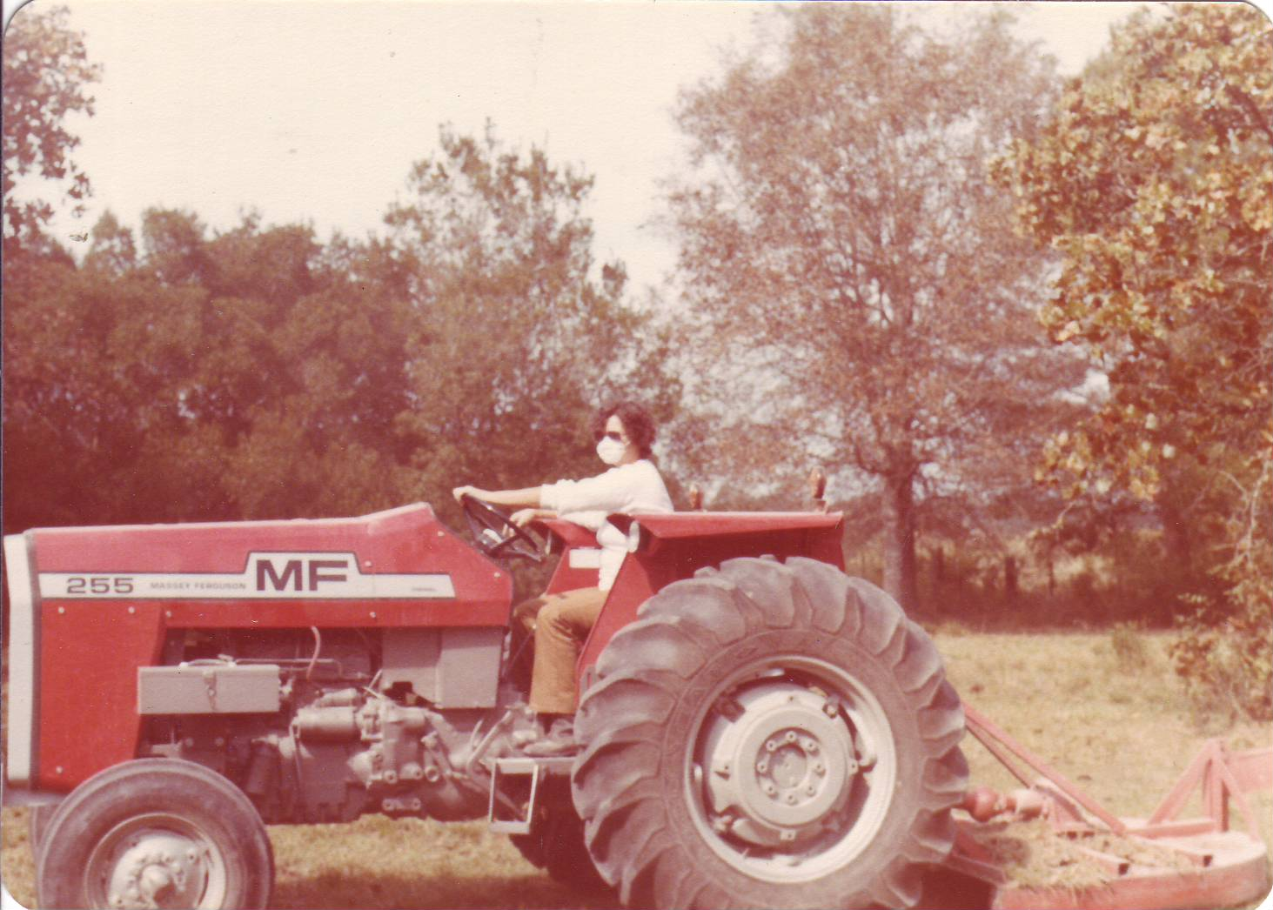
Shewolf at WomanWorld, 1980

Slide 10
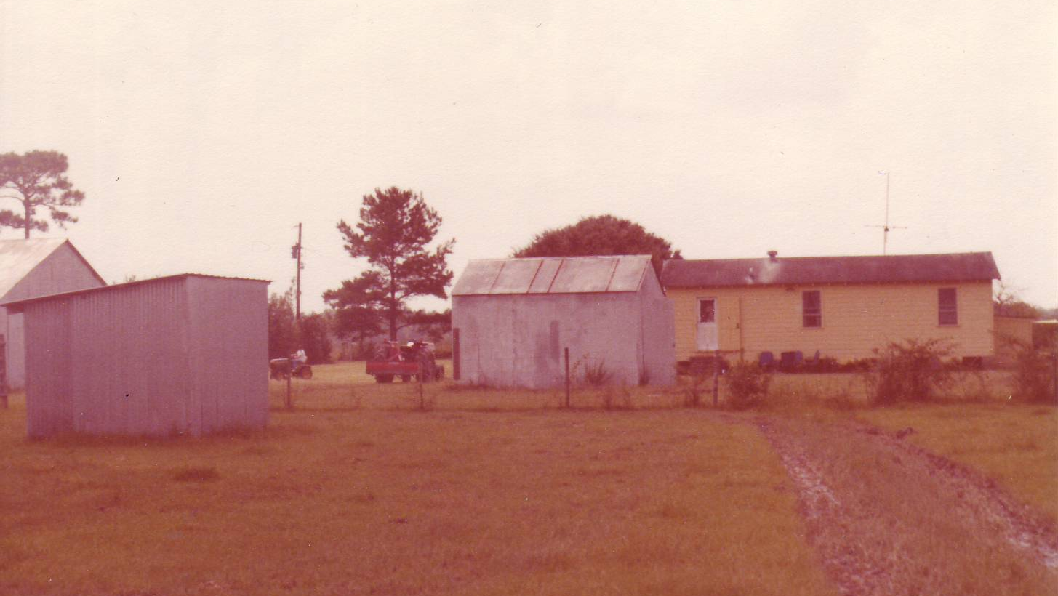
WomanWorld, 1981

Slide 12
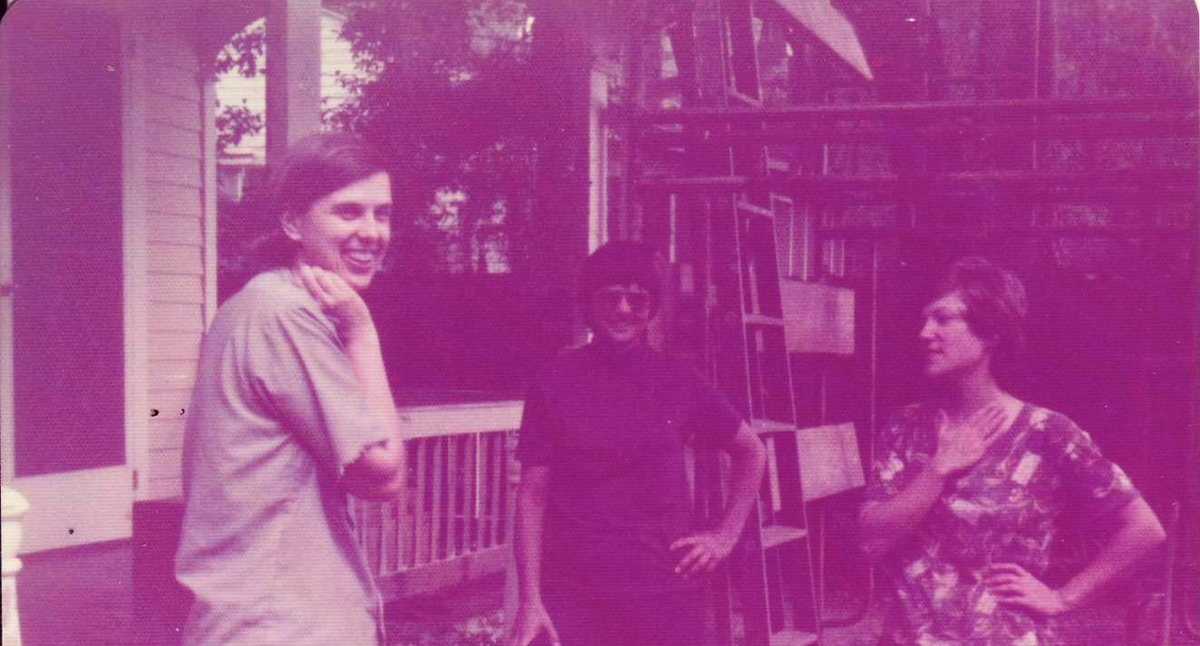

Slide 16
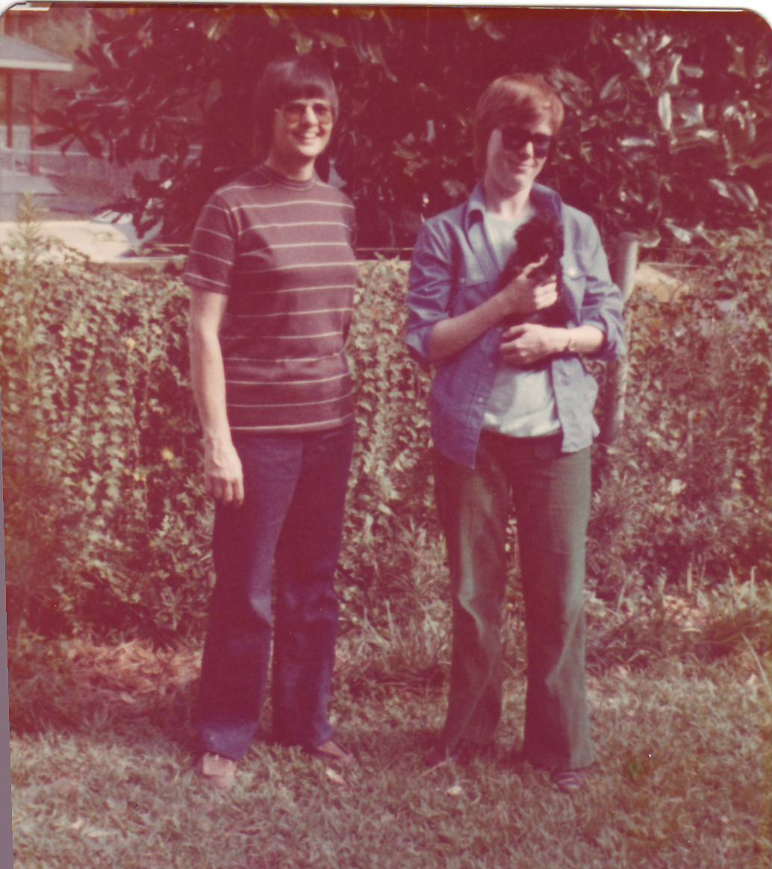

Slide 17
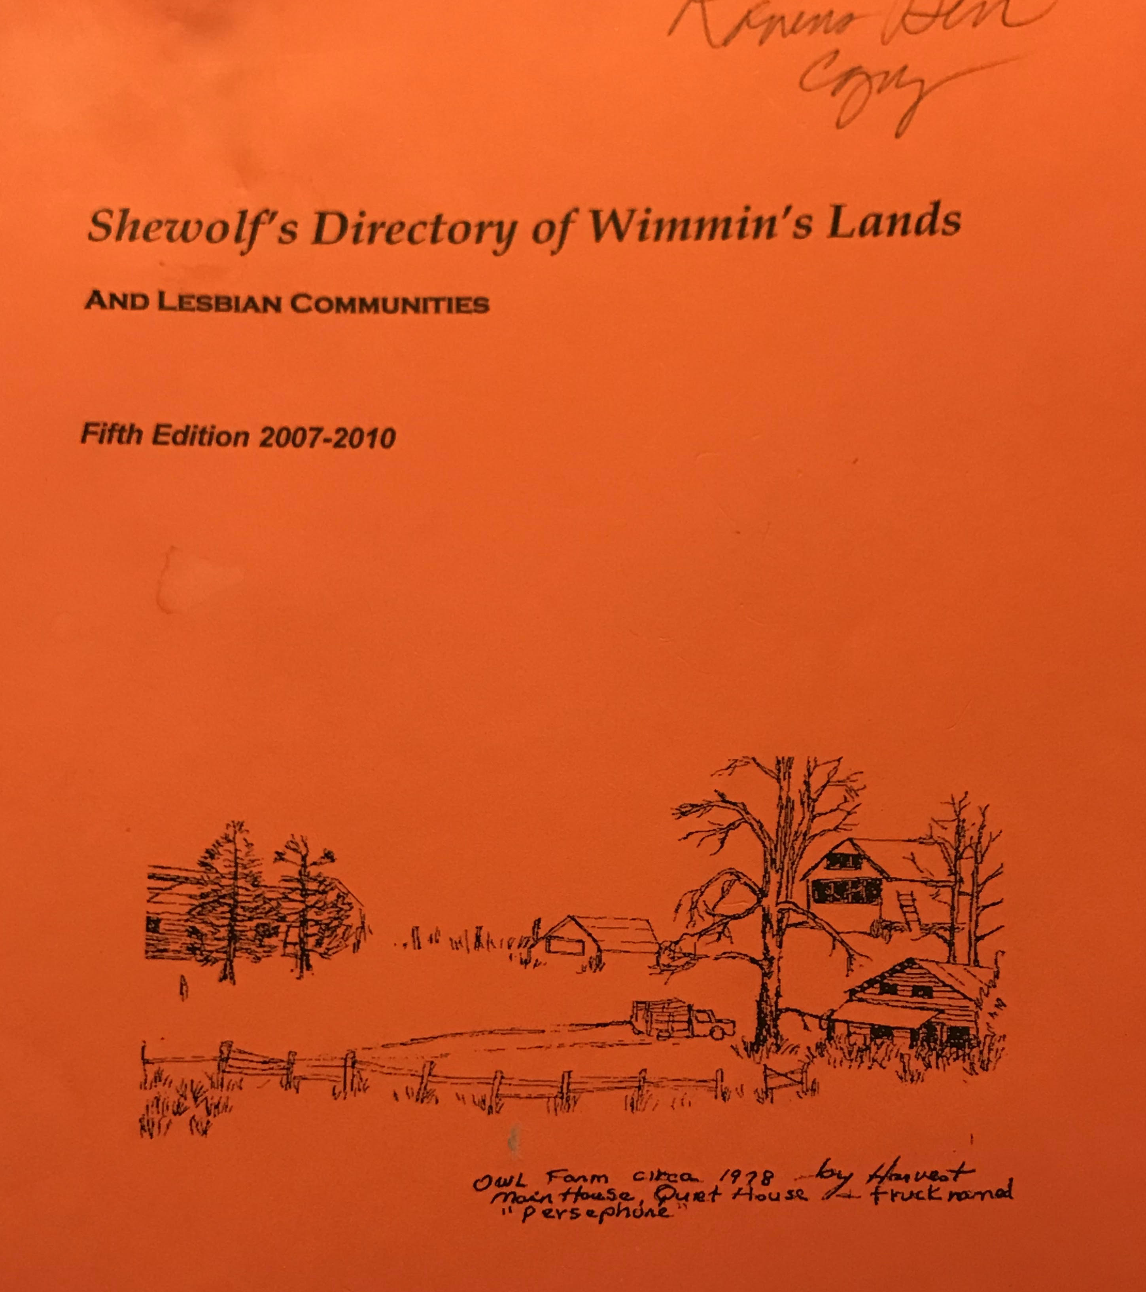

Slide 18
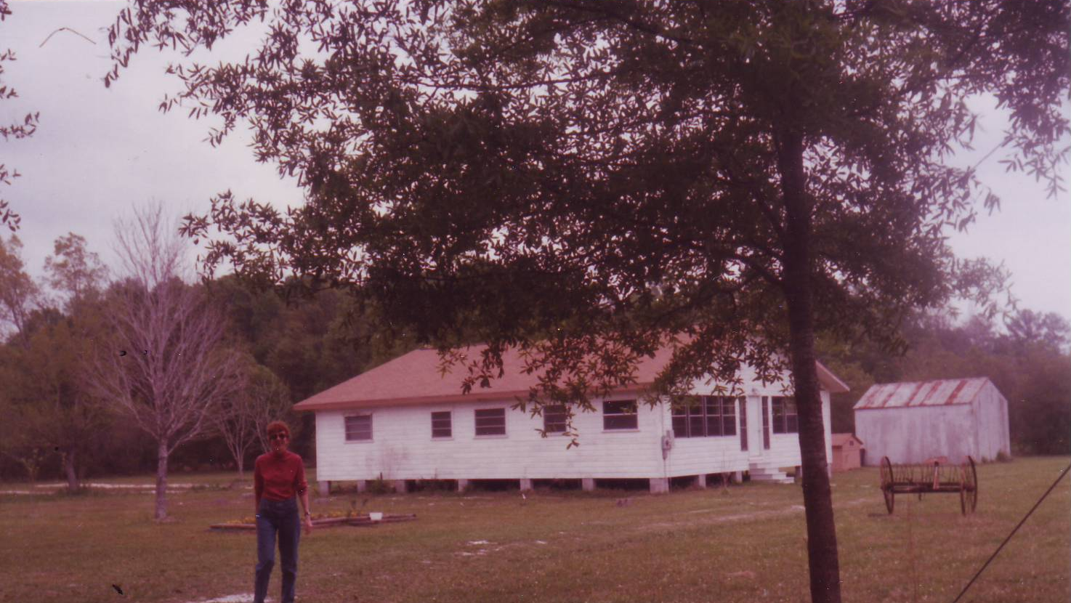

Slide 21
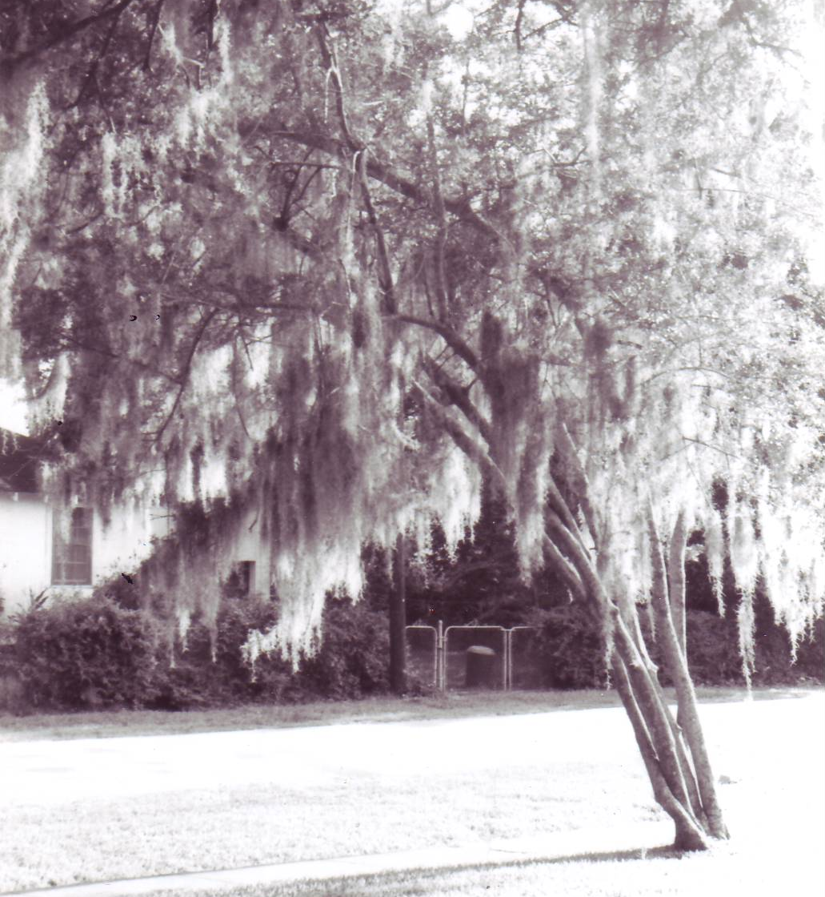

Slide 22
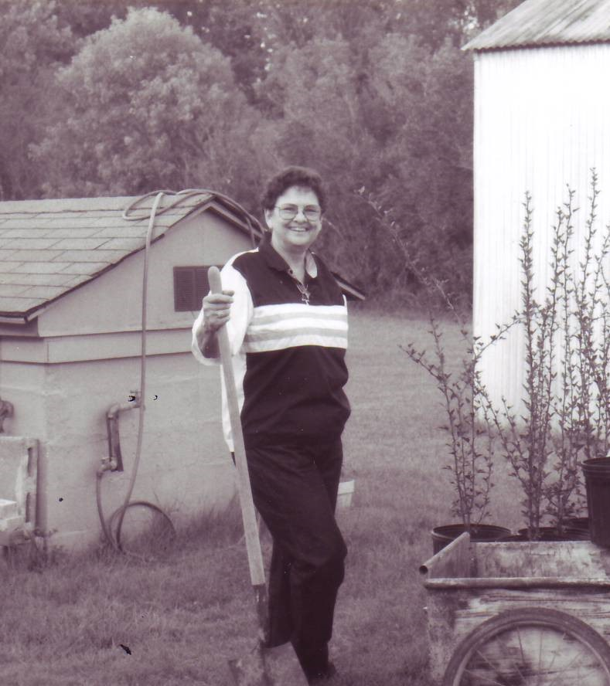

Slide 23
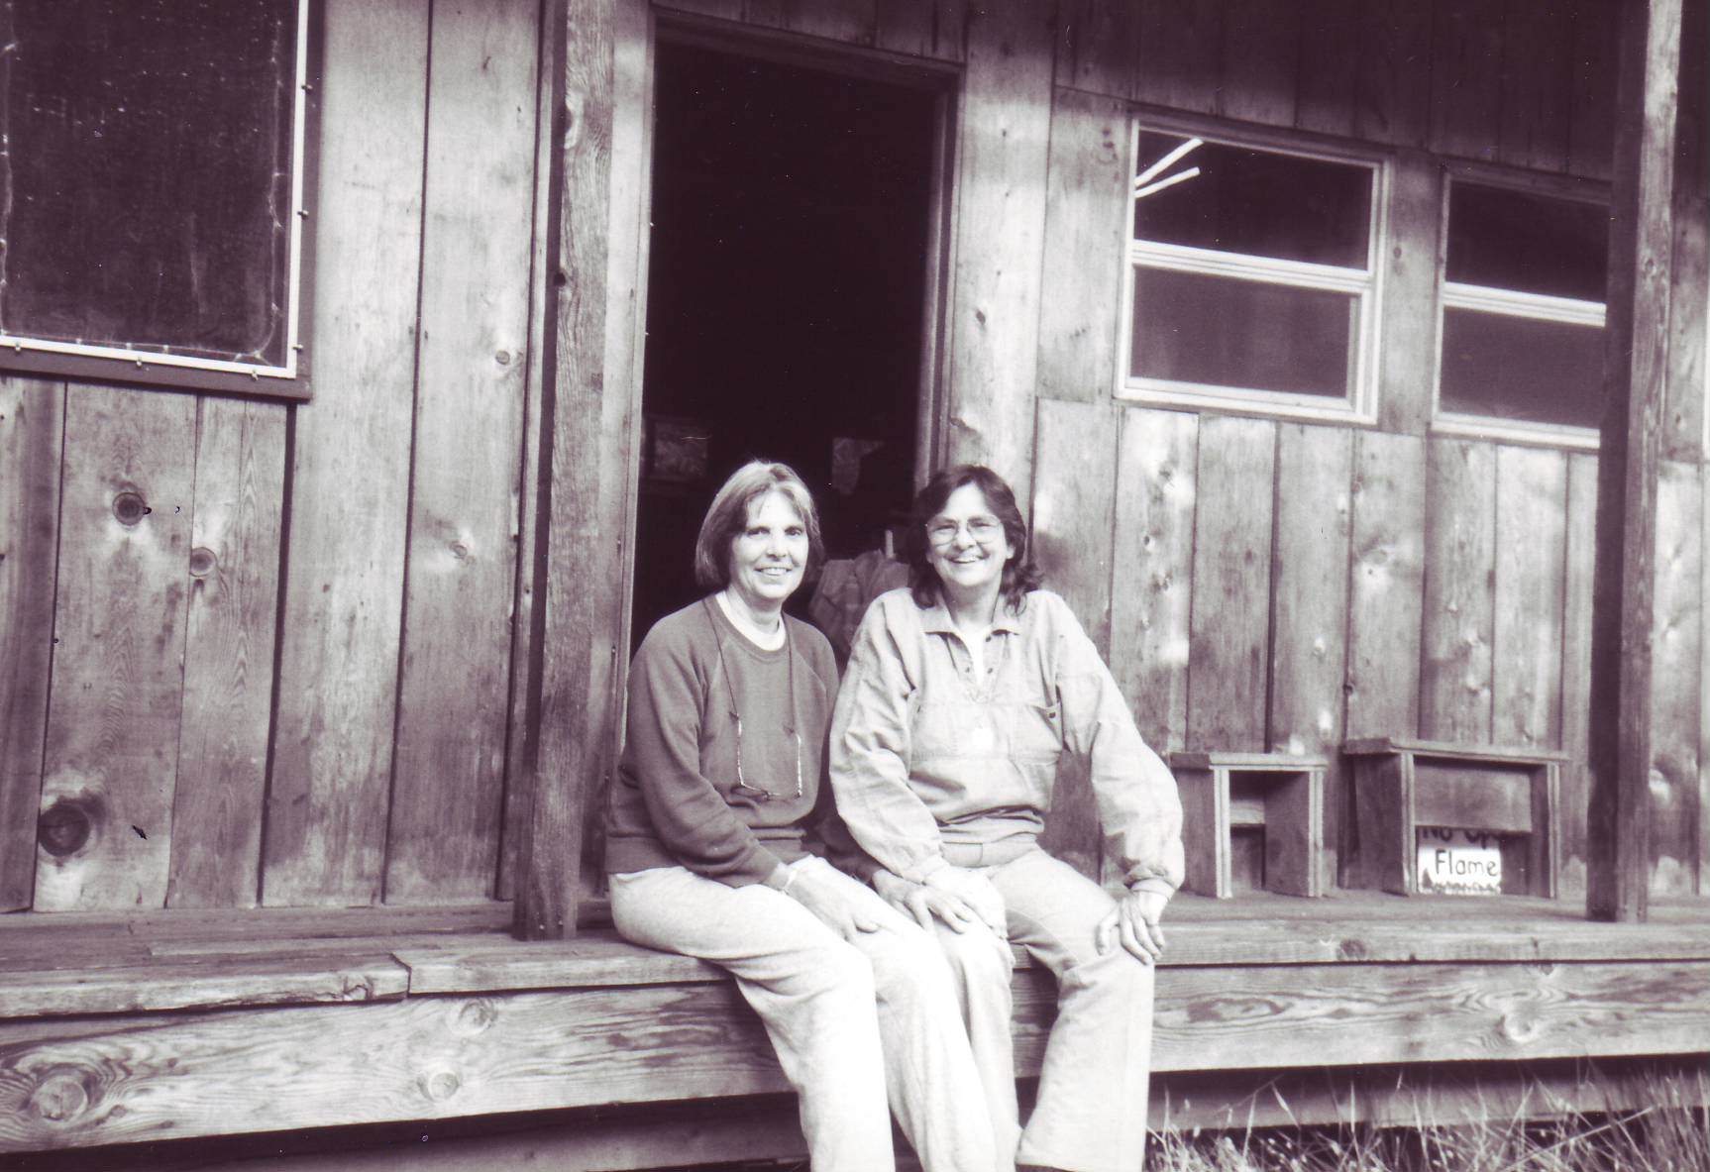
Shewolf at Rootworks 91-92 with Jean Mountaingrove; the magazine was published in this building.

Slide 24
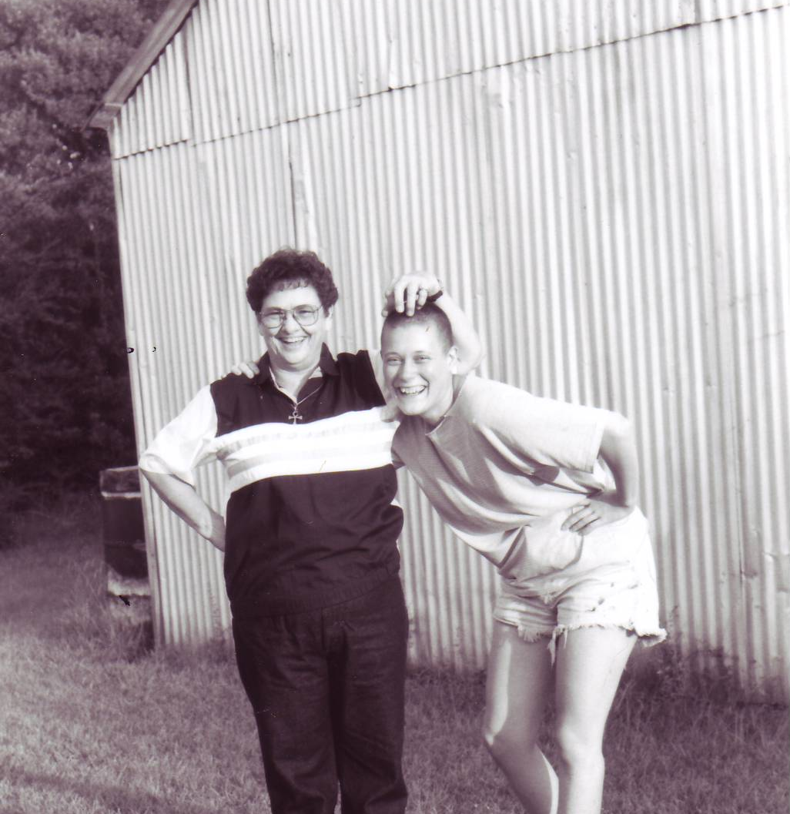
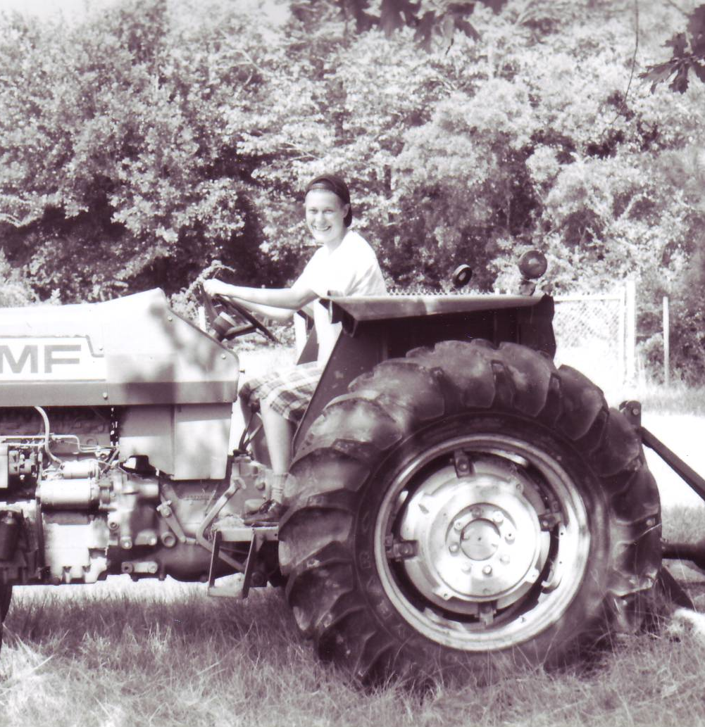

Slide 25
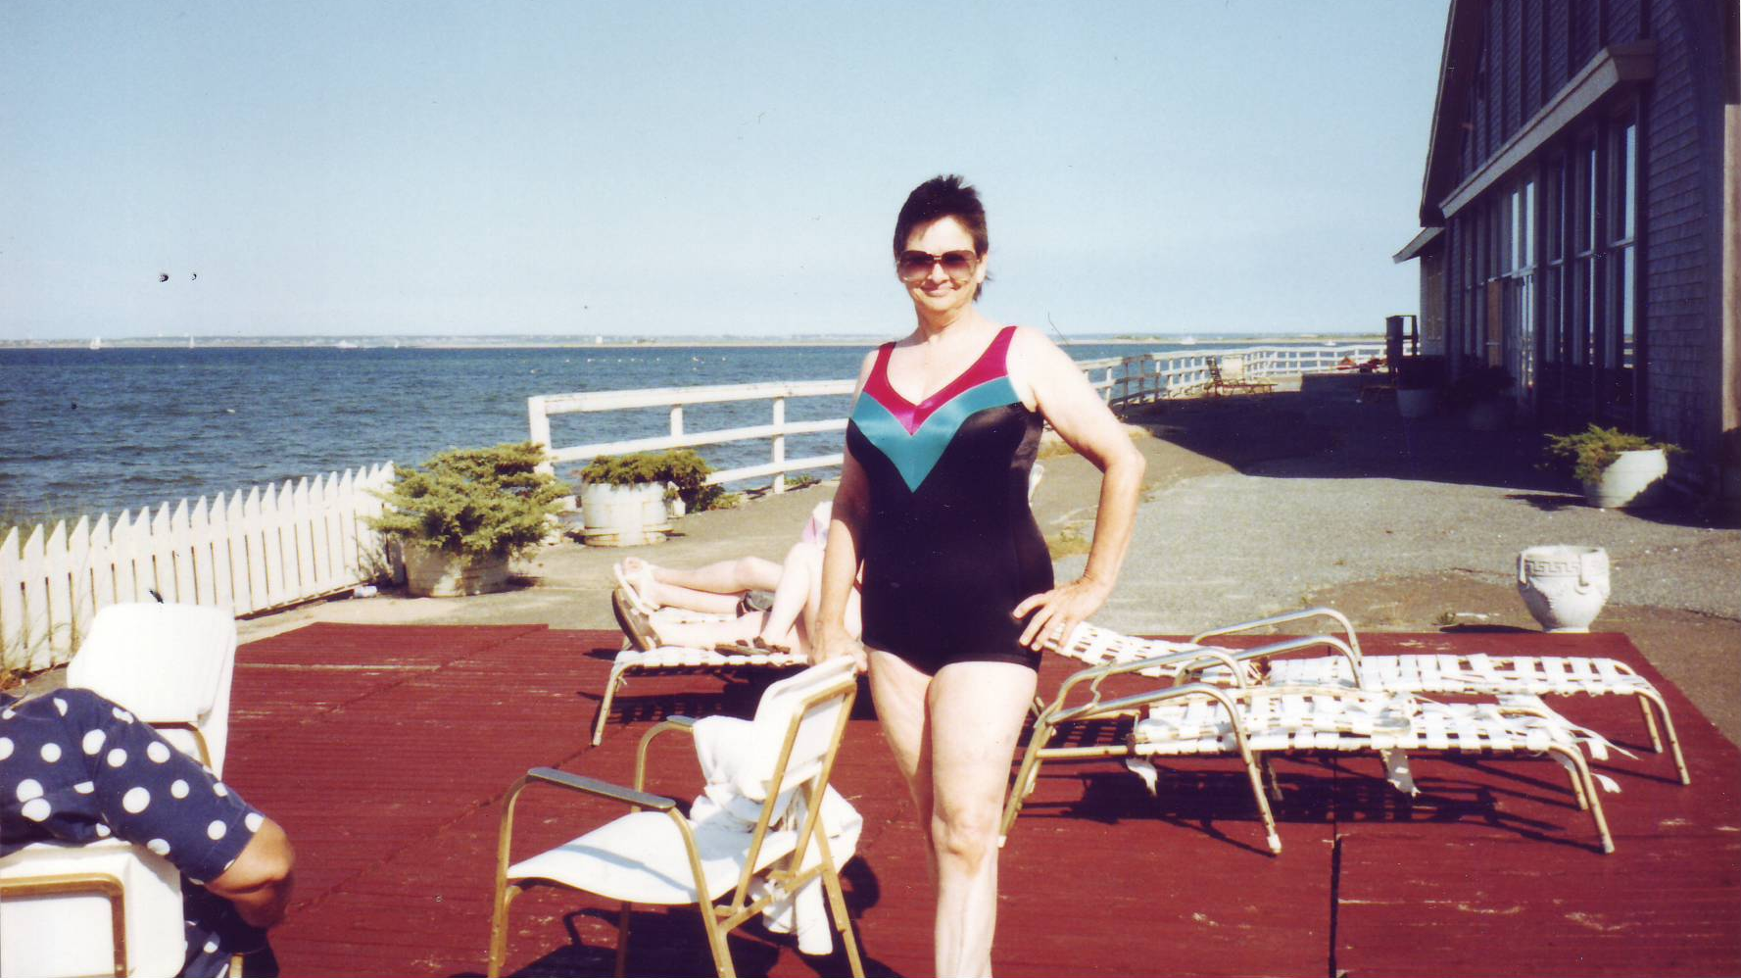
Shewolf, 1990

Slide 26
Shewolf, June 1991 in Provincetown

Slide 27
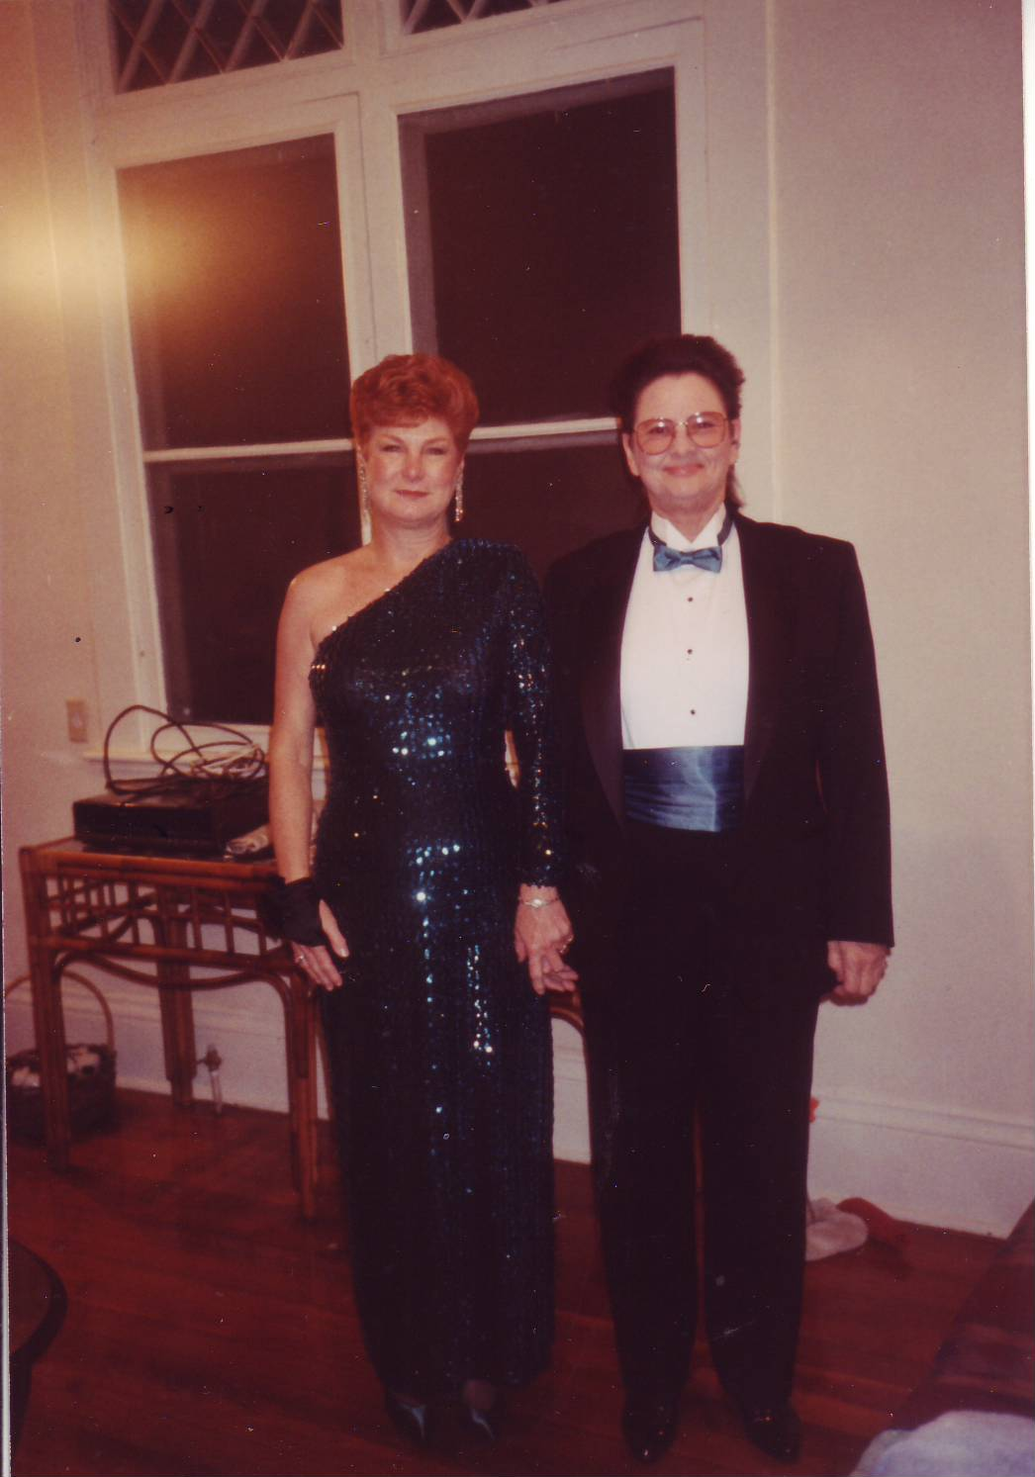
MardiGras Ball 1992

Slide 28
Shewolf’s dog, Ginger. A 13 year old Shih Tzu who now lives happily with Barbara Moore in Melrose.

Slide 29
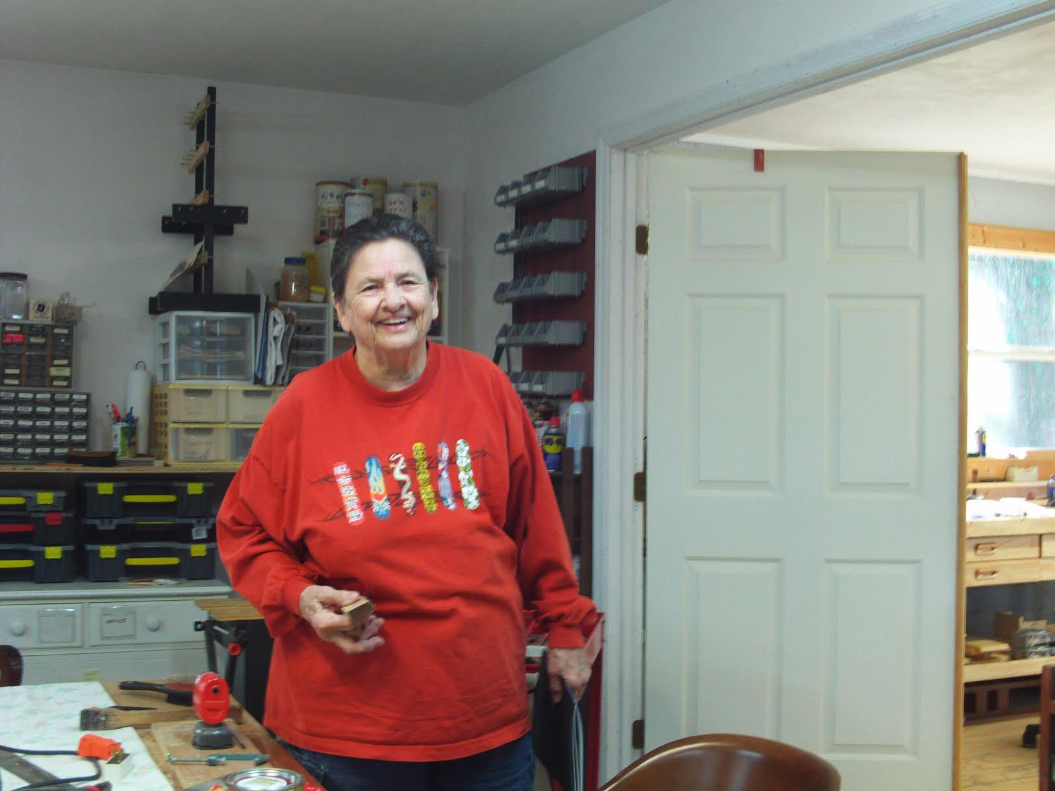

Slide 30
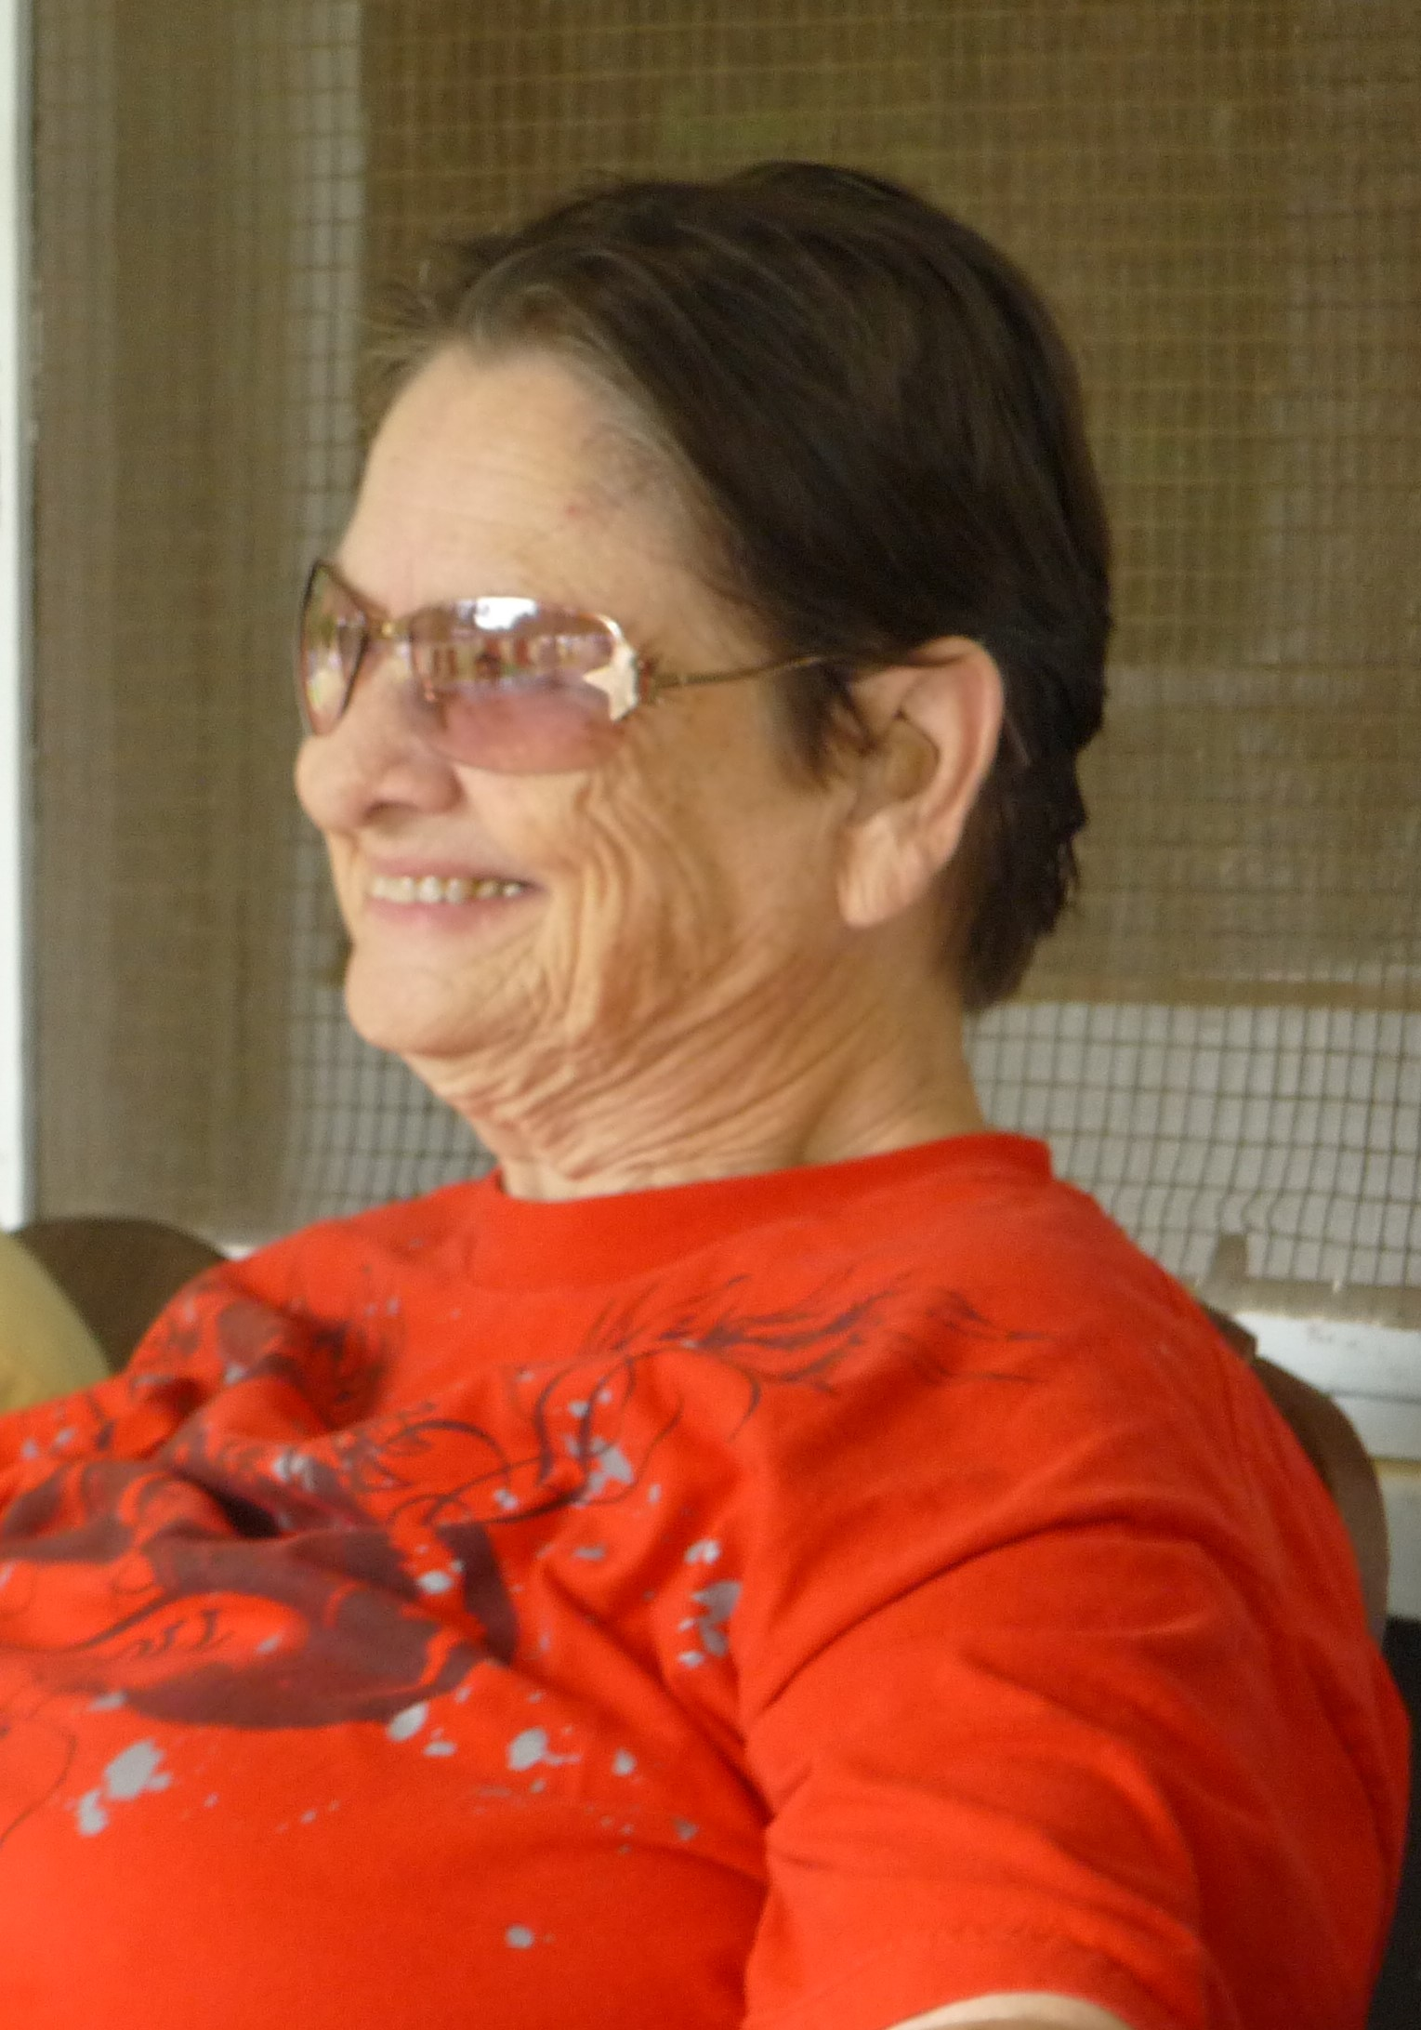
In loving memory:
Dr. Jean “Shewolf” Boudreaux
March 19th, 1932 – April 24th, 2020
Song: Sky Dances by Holly Near ft Emma's Revolution

